Slide 1
Why Haven’t Human Rights Arrived in Uganda?
By Sophia Draper, and Hannah Brown

Slide 2
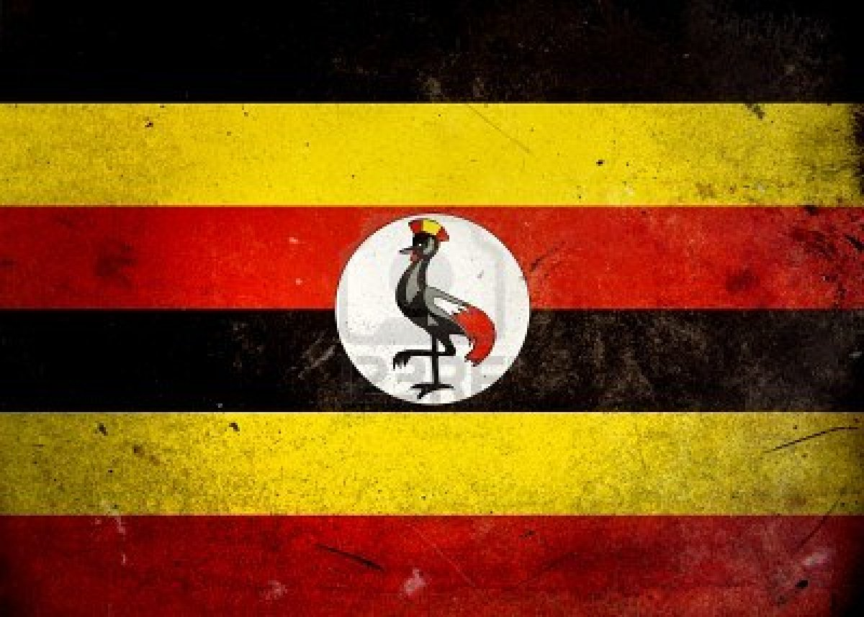
Table of contents
Colonial history
Uganda becomes an independent country
President Idi Amin
President Obote
President Museveni

Slide 3
Colonial History
The first Europeans to visit Uganda were British explorers named John Hanning Speke and James Grant, who were searching for the source of the Niall River, in 1862
Soon both Protestant and Roman Catholic missionaries were working in Buganda (a subnational kingdom in Uganda)
Within a decade, the small group they had created caused a civil war
Once it was isolated, the region had become a major object of the European nations’ scramble for African territory

Slide 4
After securing German recognition of its rights, Britain moved to secure Buganda
Frederick Lugard from the British East Africa Company, ended the civil disturbances
His successors used the Bugdandan army to help conquer the other kingdoms and tribes
By 1896, a British protectorate administration had extened its authority over most of the reign
The name Uganda was adopted

Slide 5
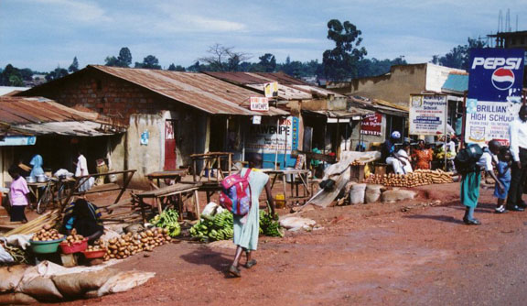
A Ugandan village

Slide 6
Uganda Becomes an Independent Country
Britain ruled Uganda for almost 70 years
Britain took over and took away their kingdoms, and tribes
This worked fairly well until the independence movements of the 1960’s
Buganda didn’t want to be part of Uganda any longer

Slide 7
Milton Obote became Prime minister
Federal consitution was published in April 1962
The Uganda People’s Congress won the elections the Milton Obote became Prime Minister
They gained independence in October 1962
In May, 1966, Milton Obote Sent an army to Buganda, and drove the Kabaka in to exile

Slide 8
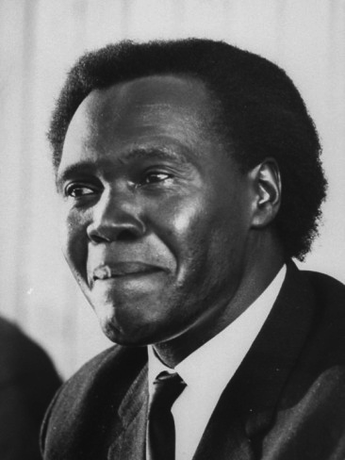
Milton Obote

Slide 9
President Idi Amin
In 1971 Idi Amin seized power in a military coup
He ruled for 8 years
This was a period of massive human rights violations, economic decline, social disintagration,
Most infrastructure for basic services was destroyed
Amin develpoed a powerfull army
He murdered his political opponunts
And he ordered the killing for an estimated 300,000 people

Slide 10
In 1979, Uganda went bankrupt
They got massive loans from Arab states, who liked Amin
Uganda went to war with Tanzania in late 1978
Tanzanian foces allied themselves with Ugandan rebels, and drove Amin out of the country in early 1979

Slide 11
Idi Amin

Slide 12
President Obote
In 1980, Obote became the president of Uganda
Uganda had changed radically since he had been the president
The nation had suffered prolonged economic disaster
There were few jobs, excessive crime, a famine in the north, and no effective government in the countryside

Slide 13
In 1982, anti-government guerillas became active, and bloody group feuds flourished
Thousands of young men were arrested, suspected of being guerillas
Obote’s management became as murderous and powerful as Amin’s
More then 100,000 Ugandans were killed or starved to death over the next 3 years

Slide 14
President Museveni
In July 1984 an army lead by Yoweri Museveni overthrew the government and took over the county
Involving all ethnic group and most of main political parties they largely succeeded in peace
Only the northern border near Sudan remain not peaceful where they were still small rebel groups

Slide 15
They then begin to rebuilt the county with help from many other counties
In 1996 Museveni was reelected and is still in power today

Slide 16
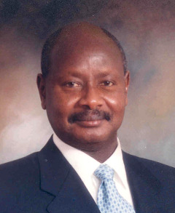
Yoweri Museveni

Slide 17
Uganda doesn’t yet have human rights, because they have had a long history of civil war within their country
The older leaders in Uganda still have some supporters
They have only started to rebuild Uganda in the last 28 years
In conclusion, they are working towards better human rights in Uganda, and it is getting better each year

Slide 18
Thanks for watching!

Slide 19
Credits
http://www.iss.co.za/Af/profiles/Uganda/Politics.html
http://en.wikipedia.org/wiki/Uganda
http://en.wikipedia.org/wiki/Yoweri_Museveni
http://www.hrw.org

